Slide 1
Data Completion and Interpolation
Jiawei Wu(jw1308)
jiawei.wu1@rutgers.edu

Slide 2
Problem
Real-World Dataset can be dirty and contains empty values.
Take titanic.csv for example:
 | Age | Cabin | Embarked
#Empty Value | 177 | 687 | 2
Table 1: Missing Value in titanic.csv
Traditional ways to deal with missing value:
Drop all the columns with missing values.
Drop row containing missing values.
Set the values to some value (zero, the mean, the median, etc.).

Slide 3
Model Description
Use various machine learning algorithms to predict the missing value.
The model is capable of handling both categorical and numerical variables.
When there are multiple missing features, the model deals with them by generating task priority and using the generated data for new prediction.

Slide 4
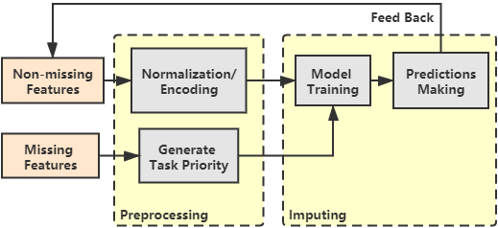
Model Description
Data Preprocessing:
Categorizing Features
Normalization/Encoding
Missing Data Imputing:
Pick machine learning algorithm
Train/Predict
Fig1: Workflow of the model

Slide 5
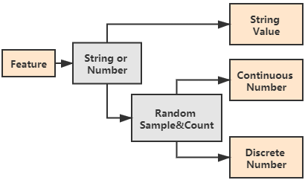
Categorizing Features
Discrete features are only having less or equal to k distinct values, where k is a positive integer set by the user.
String features can only be considered as Categorical features. Non-categorical string features are not supported currently.
Fig 2: Categorizing Features
Notes:
Balance: that’s why we have to consider O, others and I-misc separately in method 1 and select the same top k tokens for each label in method 2. Following this maybe we can tell how we got method 1+ naturally.

Slide 6
Handling Non-Missing Features
Continuous Number: Mean normalization
String: One-hot encoding
After this step, features can be directly fed into machine learning algorithms.

Slide 7
Handling Missing Features
For features of discrete values, we need to train a classifier.
For features of continuous values, we need to train a regressor.
If there are multiple missing features, we assign classification tasks a higher priority than the regression task basing on two reasons:
Regression models would be more precise if there are more features, as we are hoping to minimize the mean square error.
After we finish the classification task of string features, we will be having more features as we are encoding this feature to an array for the next step.

Slide 8
Missing Data Imputing
Classification tasks:
KNN, Decision Tree, Random Forest
Regression tasks:
Naive Regression, Ridge Regression, Lasso Regression
Basic Completion:
Discrete features: fill missing value with the mode of the feature.
Continuous features: fill missing value with the mean of the feature.
Best Model: Iterate through all methods and pick the best (highest accuracy or smallest RMSE)
Notes:
85%, 50% are hyper-parameters

Slide 9
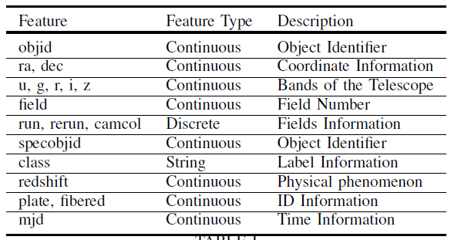
Datasets
Sloan Digital Sky Survey DR14:
10,000 observations of space taken by the SDSS.
3 discrete integer features
1 string features
14 continuous features
Table 2: Dataset description.
https://www.kaggle.com/lucidlenn/sloan-digital-sky-survey
Notes:
50 is hyper parameter

Slide 10
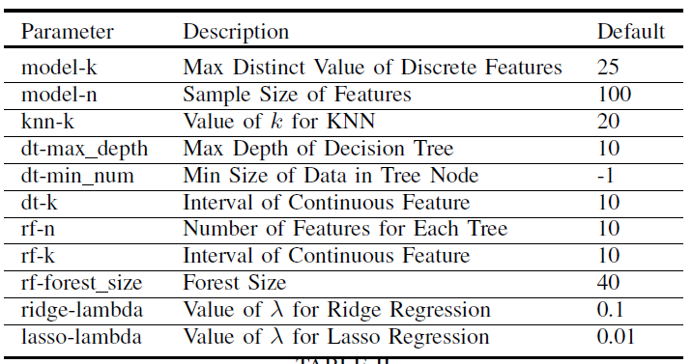
Parameters Setup
All parameters are stored in configure.txt
Table 3: Parameters description.
Notes:
50 is hyper parameter

Slide 11

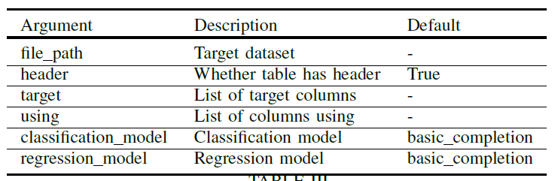
Executing
Table 4: Arguments description.
Notes:
50 is hyper parameter

Slide 12
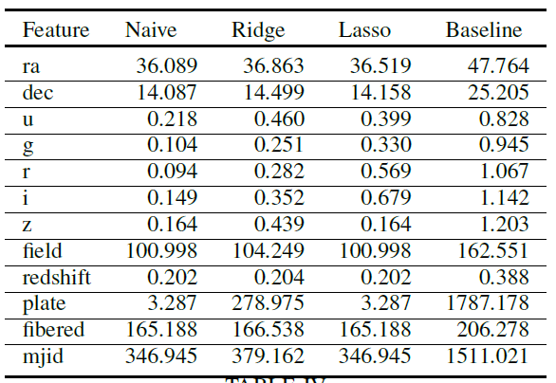
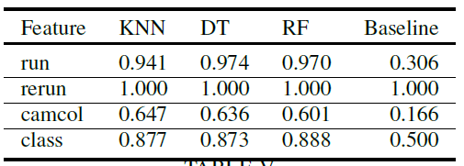
Result
Table 5: RMSE of regression tasks
Table 6: Accuracy of classification tasks
Notes:
50 is hyper parameter

Slide 13
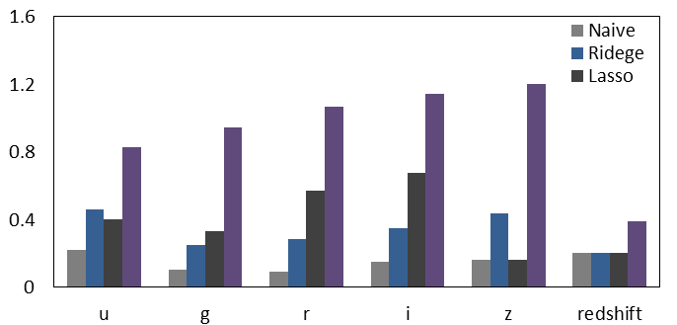
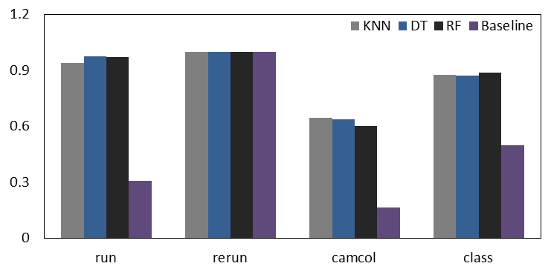
Valuable Features
Fig 3: Valuable features.
u, g, r, i, z represent the response of the 5 bands of the telescope.
run, rerun and camcol are features providing information describing a field within an image taken.
redshift is related to a physical phenomenon, which can also have an influence on the experiment.
Notes:
50 is hyper parameter

Slide 14
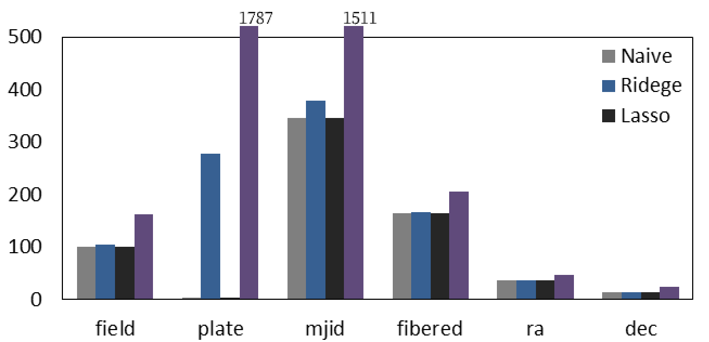
Invaluable Features
Fig 3: Invaluable features.
These features can be useless information such as id or time. For example, filed, fibered, plate are id information and mjid is time information.
The features ra and dec are not strictly related to the experiment as they only provide coordinate information while the aim of this dataset is to classify whether an object is a galaxy, star, or quasar.
Notes:
50 is hyper parameter

Slide 15
Conclusion
The tool is easy to use
Easy to execute and change parameters.
Highly extendable.
The tool is powerful
Good performance.
Can handle multiple missing features.
Is able to pick the best model for users.
Notes:
50 is hyper parameter

Slide 16
Feature Work
Add more machine learning algorithms to the support list.
Generate suitable parameters for the users automatically.
Extend the model by trying to generate new rows.
Notes:
50 is hyper parameter

Slide 17
Reference
E. Fix, Discriminatory analysis: nonparametric discrimination, consistency properties. USAF school of Aviation Medicine, 1985, vol. 1.
J. R. Quinlan, “Induction of decision trees,” MACH. LEARN, vol. 1, pp. 81–106, 1986.
Tin Kam Ho, “Random decision forests,” in Proceedings of 3rd International Conference on Document Analysis and Recognition, vol. 1, 1995, pp. 278–282 vol.1.
H. L. Seal, “Studies in the history of probability and statistics. xv the historical development of the gauss linear model,” Biometrika, vol. 54, no. 1-2, pp. 1–24, 1967.
A. E. Hoerl and R. W. Kennard, “Ridge regression: Biased estimation for nonorthogonal problems,” Technometrics, vol. 12, no. 1, pp. 55–67, 1970.
R. Tibshirani, “Regression shrinkage and selection via the lasso,” Journal of the Royal Statistical Society: Series B (Methodological), vol. 58, no. 1, pp. 267–288, 1996.

Slide 18
Thank you
for your attention!

